Slide 1
Java Basics
Introduction to Oriented Object Programming

Slide 2
Disclaimer
Document Name:
Data Classification: INTERNAL
Disclaimer
The contents of this document are property of Softtek, and are classified as Confidential. Any reproduction in whole or in part is strictly prohibited without the written permission of Softtek.
This document is subject to change. Comments, corrections or questions should be directed to the author.
Audience/Viewership | Purpose
Java Beginners | Training
Revision Chart
The following chart list the revisions made to this document. Use this to describe the changes and additions each time this document is re-published. The description should be detailed as possible and include the names of the reviewers who request the changes.
Version No. | Version Date | Types of Changes | Owner/Author | Date of Review/Expiration
1 | 2015/07/22 | Creation | Luis Robles | NA

Slide 3
Lesson 2: Introduction to Oriented Object Programming

Slide 4
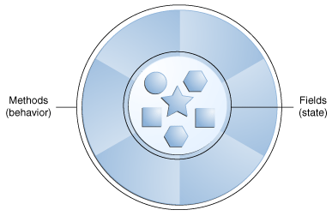
Concepts
Object-Oriented Programming (OOP) uses a different set of programming languages than old procedural programming languages (C, Pascal, etc.).
OOP is a design philosophy.
Everything in OOP is grouped as self sustainable "objects".
An object can be considered a "thing" that can perform a set of related activities and has an state.
The set of activities that the object performs defines the object's behavior.
The set of activities changes the object state.

Slide 5
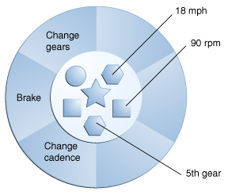
Concepts (cont.)
Real-world objects share two characteristics: They all have state and behavior.
Identifying the state and behavior for real-world objects is a great way to begin thinking in terms of object-oriented programming
Notes:
For instance:
Bicycles also have state (current gear, current pedal cadence, current speed) and behavior (changing gear, changing pedal cadence, applying brakes).
By attributing state (current speed, current pedal cadence, and current gear) and providing methods for changing that state, the object remains in control of how the outside world is allowed to use it. For example, if the bicycle only has 6 gears, a method to change gears could reject any value that is less than 1 or greater than 6.

Slide 6
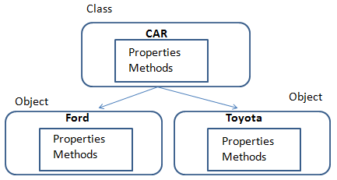
Concepts (cont.)
A class is simply a representation of a type of object.
It is the blueprint, or plan, or template, that describes the details of an object.
A class is the blueprint from which the individual objects are created.
Class is composed of three things: a name, attributes (properties) and operations (methods).
An object is an instance of a specific class.

Slide 7
Concepts (cont.)
Fundamental principles of OOP:
Encapsulation: hide unnecessary details in our classes and provide a clear and simple interface for working with them.
Hiding internal state and requiring all interaction to be performed through an object's methods
Abstraction: to deal with objects considering their important characteristics and ignore all other details. Abstraction reduces complexity by hiding irrelevant detail.
Polymorphism: to work in the same manner with different objects, which define a specific implementation of some abstract behavior.
Inheritance: class hierarchies improve code readability and enable the reuse of functionality

Slide 8
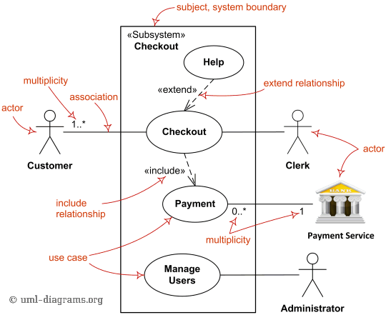
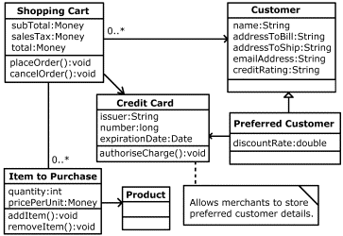

Modeling
The Unified Modeling Language™ - UML - is OMG’s (Object Management Group) most-used specification, and the way the world models not only application structure, behavior, and architecture, but also business process and data structure.
Notes:
Using a Modeling tools such as:
Rational Rose
Enterprise Architect
StarUML
Etc.

Slide 9
Links and References
http://docs.oracle.com/javase/tutorial/java/concepts/index.html
http://www.uml.org/

Slide 11
Luis Robles
luisf.robles@softtek.com
Related to training material (Java Basics module)
Diego Olvera
diego.olvera@softtek.com
Instructor

